Slide 1
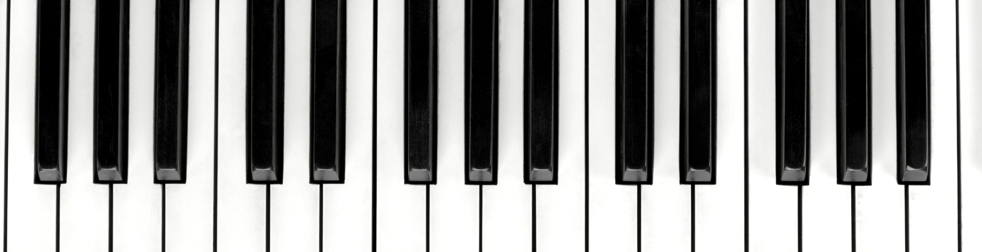
Music Genre Classification
KARIM HAZIMEH
ELSY HOBEIKA
AMAL NAHLE
ANTHONY-JOE ZOUGHEIB

Slide 2




Explosive growth of songs released daily
Easy access to music platforms by artists/singers
Difficulty for streaming services to classify the genre of every newly released songs
Automated music genre classification :
Decreased labor time & costs
Better user experience by providing a better music recommendation system

Slide 3






Music Genre
Most important component in describing music content
Audio signals carry information about music genre
Members sharing common characteristics that can be differentiated from other genres
(rhythm, melody, harmony…)
Algorithms try to model these signals through their statistical distribution of the features

Slide 4



Objective
Using deep learning and developing different machine learning models that would enable automatic music genre classification.
Try to improve the accuracy reached by other authors on the chosen dataset.

Slide 5

Related Work
Dong (2018)
GTZAN dataset
Features extracted from spectrograms (LibROSA library)
Each audio file consisting of 30 seconds was split into a 3-seconds file
Split into training and test sets through cross-validation
CNN
Different accuracies reached across different genres
Highest accuracy (70%) for classical & blues music genres

Slide 6
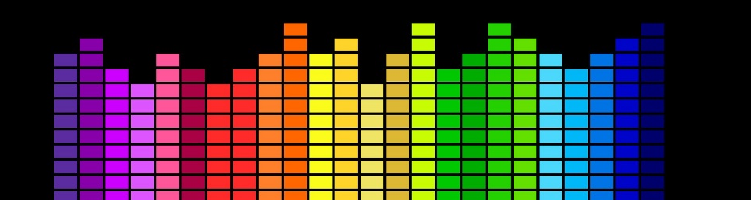

Dataset
GTZAN dataset
Available online for free
10 files each containing 100 – 30 seconds audio song excerpts
Each file represents a specific music genre
Total number of audio files: 1000
Jazz
Pop
Country
Disco
Reggae
Classical
Hip-Hop
Blues
Metal
Rock

Slide 7
Data Splitting
80-20%
Original data set: 1000 audio files – 30 sec
Data was divided into 3 sec files, increasing the overall amount of data
Test Train Split
Train/validation sets split through cross-validation

Slide 8

Feature Extraction
Feature Extraction as Numerical Values
- From each file: 83 audio features extracted
- Python’s LibROSA library for audio analysis
- Done on both sets
Feature Extraction as Images
- Mel spectrograms extracted as images
- Don the 30-seconds data set

Slide 9

Features
Three essential types: rhythmic, timbral texture, and pitch content
MFCCs: timbral texture features; “color” or “quality” of the sound
Zero crossing rate: timbral texture feature; measures the “smoothness” of the audio signal or the existence of a percussive sound
Spectral Spread: timbral texture feature; refers to the brightness of the signal’s sound
Chroma Features: pitch content features associated with notes played throughout a song
Tempo: rhythmic feature; number of beats/minute (speed)
Mel Spectrogram: visual representation of the signal; how the frequencies spectrum change over time

Slide 10
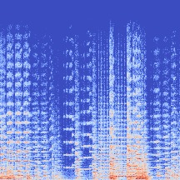
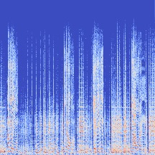
Mel-Spectrogram
Classic
Blues

Slide 11

Pre-processing
Done for numerical features
Removing corrupted files (data = 999 records)
Checking for duplicates
Min-Max scaling

Slide 12

Machine Learning Models
RandomizedSearchCv
Model | Accuracy (30 sec dataset) | Accuracy (3 sec dataset
Gaussian Naïve Bayes | 57% | 52%
SVM | 75% | 87%
Logistic Regression | 72% | 56%
Random Forest | 70% | 81%
KNN | 67 | 89%
Leaf_size = 7 ; N_neighbors = 3 ; P = 1

Slide 13
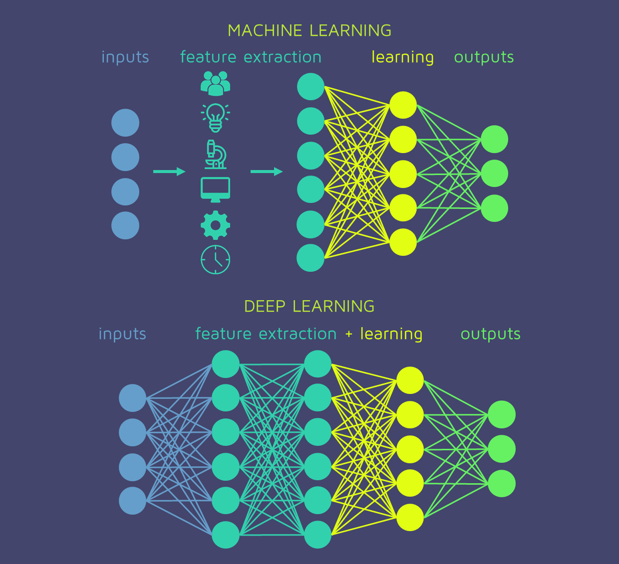
Deep Learning
model | Param / arch | Valid score
CNN 30s | 3 Convolutional layers RELU activation 128 units 30 iterations | 56%
NN 3s | 3 dense : 256,128 ,64 Softmax RELU dropout 70 epochs Adam optimizer | 87%
NN 3s | 5 dense : 512, 256,128 ,64 Softmax RELU dropout 20 epochs Adam optimizer | 87.8%
NN 3s | 5 dense : 512, 256,128 ,64 Softmax RELU dropout 150 epochs Stochastic Gradient Descent optimizer | 86.3%

Slide 14

Models Comparison
Model | Parameters / architecture | Train | test
Logistic Regression 30 seconds | Solver= ‘saga’ Penalty= ‘l2’ C= 100 | 88% | 73%
KNN On 3s | Leaf_size = 7 N_neighbors = 3 P = 1 | 99% | 88%
CNN On 30s mel-spectrogram | 3 Convolutional layers, dense layer of 128 RELU activation. 30 iterations, | 85% | 71%
NN | 5 dense : 512, 256,128 ,64 Softmax RELU dropout 150 epochs Stochastic Gradient Descent optimizer | 96% | 87%

Slide 15


Conclusion & Recommendation
The best model is the NN model with an accuracy of 87% reached on the 3-second data set compared to an overall accuracy of 82.5% reached by Bergstra et al (2006), around 78.5% by Li et al. (2003), and 78.2% by Panagakis et al (2008).
We recommend companies to start investing in ML for automating music classification.
This will help provide a better service for customers
A better service means retaining customers, increasing customer loyalty, and targeting more segments.
This will result in more revenues for the company, and a decrease in labors cost for labelling and human errors

Slide 16


